Slide 1

CMR COLLEGE OF ENGINEERING & TECHNOLOGY
Kandlakoya, Medchal, Hyderabad - 501401
Department of Computer Science and Engineering
Fake Account Detection on social media using Artificial Neural Networks
Under esteemed guidance of
Ms. M. Kamala Assistant Professor
Batch 28
M. Mounika 19H51A05N8
Moin Ashiq 19H51A05P0 N. Harika Ratna 19H51A05P4

Slide 2


Slide 3
Contents
Abstract
Introduction
Literature review - Existing system
- Problems in existed system
Research Object of presentation
Proposed Definition
Research Work - Proposed system Architecture - Methods - Comparison of prosed system with an existed system
Performance Measure
Results
Conclusion
Future Work
References

Slide 4
ABSTRACT

Slide 5
ABSTRACT
In present times, social media plays a key role in every individual life. Everyday majority of the people are spending their time on social media platforms.
The number of accounts in these social networking sites has dramatically increasing day-by-day and many of the users are interacting with others irrespective of their time and location.
Hence, this research aims to detect fake users based on the user's profile using ANN, which can detect fake accounts with more accuracy than other algorithms.

Slide 6
Introduction

Slide 7
INTRODUCTION
Modern society, social media plays a vital role in everyone's life. The general purpose of social media is to keep in touch with friends, sharing news, etc. The number of users in social media is increasing exponentially.
Instagram has recently gained immense popularity among social media users. With more than 1 Billion active users, Instagram has become one of the most used social media sites. These social media influencers have now become a go-to place for the business organization to advertise their products and services.
Using Social media for online fraud, spreading False information is increasing at a rapid pace. Fake accounts are the major source of false information on social media.

Slide 8

Business organizations that invest huge Sum of money on social media influencers must know whether the following gained by that account is organic or not. So, there is a widespread need for a fake account detection tool, which can accurately say whether the account is fake or not.
The process of finding a fake account mainly depends on factors such as engagement rate and artificial activity.

Slide 9
Literature REVIEW

Slide 10
PAPER - 1
FAKE ACCOUNT DETECTION USING DECISION TREE
In Multiple algorithms like decision tree, logistic regression and support vector machine algorithms were used for detection. A major drawback of the decision tree algorithm is that the tree contains data sets for a feature and not for multiple features.
Author : T. Om Prathyusha, N. Sai Kumar, E. Vishnu Priya
Issue Year : 6 June 2021
Limitations:
1.It mainly focus on one targeted feature.
2.It does not focus on multiple features.
3.Its complex process by making trees for every account.

Slide 11
PAPER - 2
FAKE ACCOUNT DETECTION USING METICS CLUSTERING
This algorithm gets the data and clusters it into different groups which made it easier to separate fake accounts from real accounts. Thus, the models which came after this minimised the number of features as done, where comparing the age entered with their registered mail id and location of the users were used as features.
Author : Cao Xiao, David Mandell Freeman, Theodore Hwa
Issue Year : November 2021
Limitations:
1.No spam detection method is used.
2.Not robust.
3.Not a language-insensitive pattern matching features.
4.It only maps to small number of character classes(uppercase or lowercase).

Slide 12
PAPER - 3
SUPERVISED MACHINE LEARNING ALGORITHMS TO
DETECT INSTAGRAM FAKE ACCOUNTS
To improve the accuracy , new features and tuning parameters were added
in the experiment.Models that perform better than other models based
on the new features and parameters with an accuracy of 0.93.
Author : Michael Jonathan Ekosputra, Angela Susanto, Ferdiana Haryanto
Issue Year : 11 February 2022
Limitations:
1.Not accurate.
2.Limited data to train.
3.High variance problems on increasing dataset.
4.Only few parameters are used.

Slide 13
Paper - 4
Fake Profile Detection in Social Network using Random Forest
The most common algorithm used by fake account detection Applications is the Random forest algorithm. The algorithm has few downsides such as inefficiency to handle the categorical variables which has different number of levels. Also, when there is an increase in the number of trees, the algorithm's time efficiency takes a hit.
Author: Latha P, Sumitra V, V. Sasikala, J. Arunarasi, A. R. Rajini, N. Nithiya
Issue Year : 12 May 2022 at Chennai.
Limitations:
1. Not accurate.
2.Uses only few features like user comments & comportments.
3.More decision trees make complexity.

Slide 14
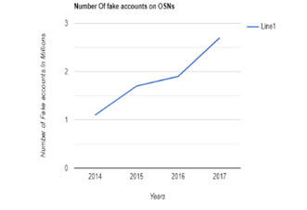
Research Objective of Presentation
In today's Modern society, social media plays a vital role in everyone's life. The general purpose of social media is to keep in touch with friends, sharing news, etc. The number of users in social media is increasing exponentially. Instagram has recently gained immense popularity among social media users. With more than 1 billion active users, Instagram has become one of the most used social media sites. These social media influencers have now become a go-to place for the business organization to advertise their products and services.

Slide 15
PROBLEM DEFINATION

Slide 16
Problem Definition
To detect and identify fake accounts from social media websites using machine learning algorithms.
An unaware curious user clicking the bad link will damage their computer. The cost can be as simple as catching a virus to as bad as installing a rootkit turning the computer into a zombie.
The widespread use of social media has turned out to be both a benefit and a liability for society. The use of social media for online fraud and the dissemination of false information is rapidly growing. On social media, fake accounts are the most popular source of false information. Businesses that spend a lot of money on social media influencers need to know if the following they've gotten is organic or not.

Slide 17
Why Fake account detection is important?
Gives more security for our profiles.
Reduces creation of false news feeds & accounts.
Decreasing of abuse, payment fraud and identity of theft.

Slide 18
RESEARCH WORK

Slide 19
Research Work
Proposed system architecture
In our solution, we use machine learning, namely an artificial neural network to determine what are the chances that a friend request is authentic or not.
We utilize Microsoft Excel to store old and new fake data profiles. The algorithm then stores the data in a data frame. This collection of data will be divided into a training set and a testing set. We would need a data set from the social media sites to train our model.
In our solution, we use machine learning, namely an artificial neural network to determine what are the chances that a friend request is authentic or not.

Slide 20
Research Work
We utilize Microsoft Excel to store old and new fake data profiles. The algorithm then stores the data in a data frame. This collection of data will be divided into a training set and a testing set. We would need a data set from the social media sites to train our model.
For the training set, the features that we use to determine a fake profile are Account age, Gender, User age, Link in the description, Number of messages sent out, Number of friend requests sent out, Entered location, Location by IP, Fake or Not. Each of these parameters is tested and assigned a value.

Slide 21
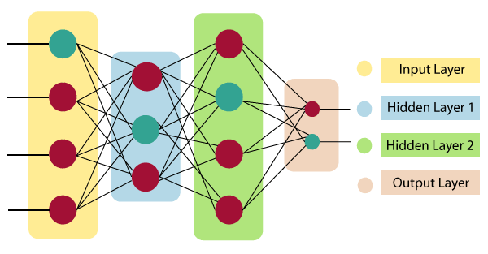
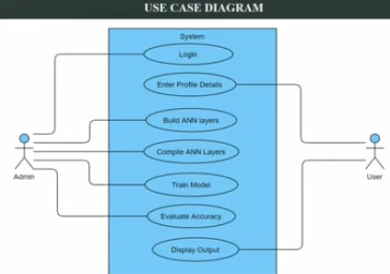
Architecture

Slide 22
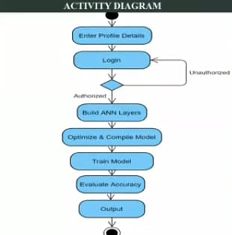
UML Diagrams
ACTIVITY DIAGRAM

Slide 23
For the training set, the features that we use to determine a fake profile are Account age, Gender, User age, Link in the description, Number of messages sent out, Number of friend requests sent out, Entered location, Location by IP, Fake or Not. Each of these parameters is tested and assigned a value. For example, for the gender parameter if the profile can be determined to be a female or male a value of (1) is assigned to the training set for Gender. The same process is applied to other parameter.
One of the popular activation function is Sigmoid. The neuron which uses sigmoid function as an activation function will be called sigmoid neuron. It used for predicting probabilities based given data.

Slide 24
METHODS

Slide 25
SOFTWARE REQUIREMENTS:
Operating system : Windows 7 Ultimate.
Coding Language : Python.
Front-End : Python.
Designing : Html, CSS, JavaScript.
Data Base : Excel Sheet

Slide 26
Important Libraries.
Machine Learning:
TensorFlow (deep learning with neural networks) *
scikit-learn (machine learning algorithms)
keras (high-level neural networks API)
Data Science:
pandas (data analysis)
NumPy (multidimensional arrays)
SciPy (algorithms to use with numpy)
HDF5 (store & manipulate data)
matplotlib (data visualization)

Slide 27
METHOD IMPLEMENTATION
Upload Social Network Profiles Dataset: Using this module we will upload dataset to application.
Preprocess Dataset: Using this module we will apply processing technique such as removing missing values and then split dataset into train and test where application use 80% dataset to train ANN and 20% dataset to test ANN prediction accuracy.
Run ANN Algorithm: Using this module we will train ANN algorithm with train and test data and then train model will be generated and we can use this train model to predict fake accounts from new dataset.

Slide 28
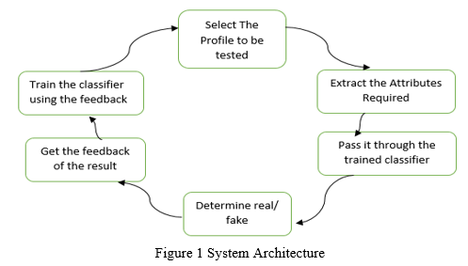
ANN Accuracy & Loss Graph: To train ANN model we are taking 200 epoch/iterations and then in graph we will plot accuracy/loss performance of ANN at each epoch/iteration.
Predict Fake/Genuine Profile using ANN: using this module we will upload new test data and then apply ANN train model to predict whether test data is genuine or fake.
System Design

Slide 29
UML Diagrams
Use Case Diagram

Slide 30
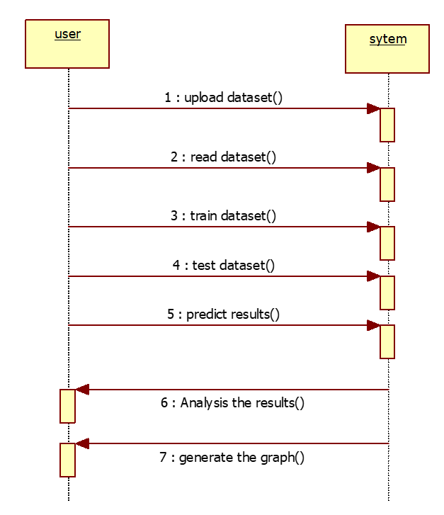
Sequence Diagram

Slide 31
COMPARISON OF PROPOSED SYSTEM WITH AN EXISTED SYSTEM

Slide 32
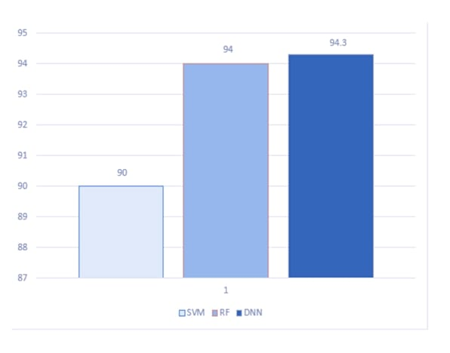
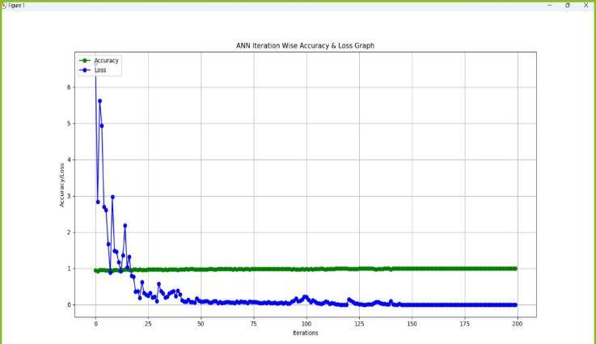
Comparison Of Proposed System With An Existed System
Existing accuracies in graph
Current accuracy in graph

Slide 33
PERFORMANCE MEASURE

Slide 34
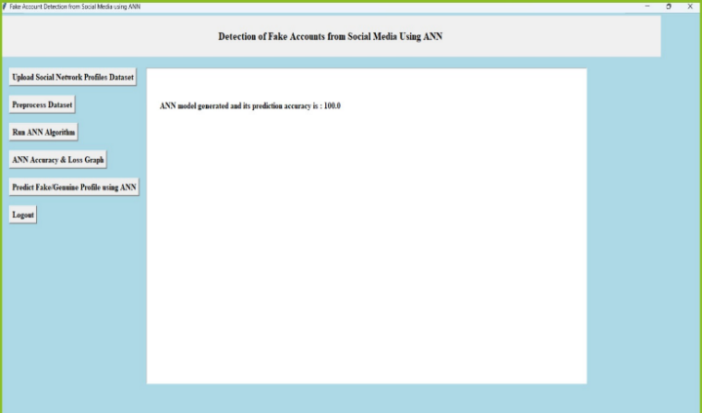

Performance Measure

Slide 35
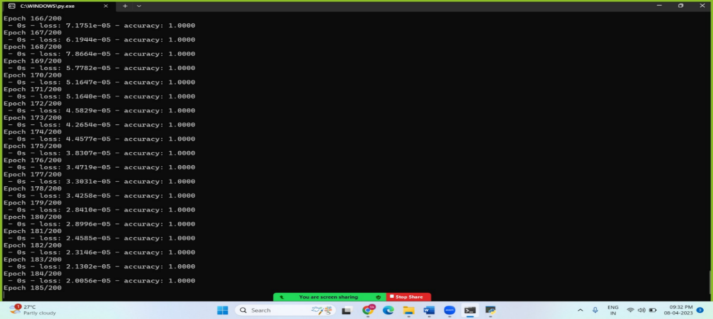
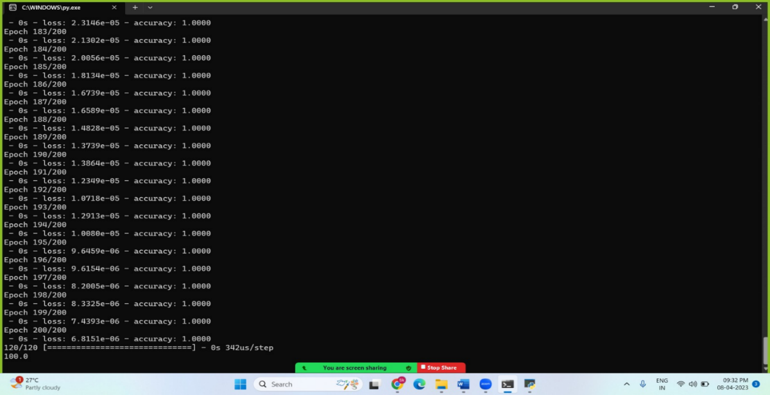

Slide 36
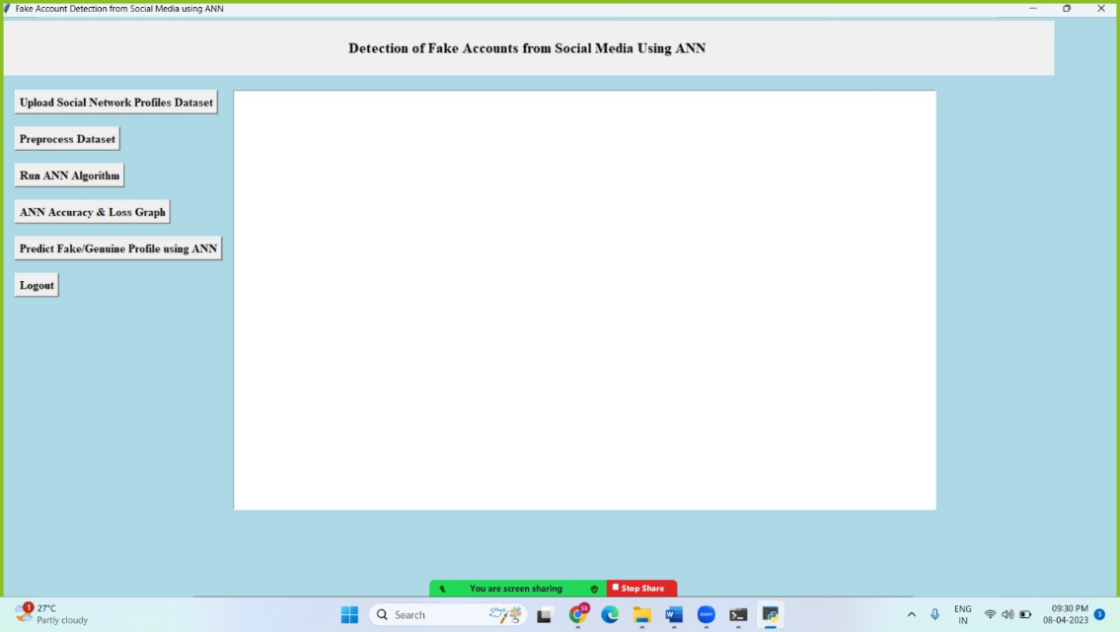
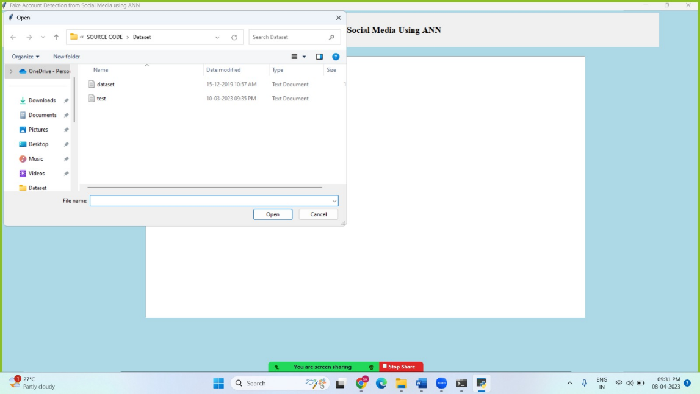
Results

Slide 37
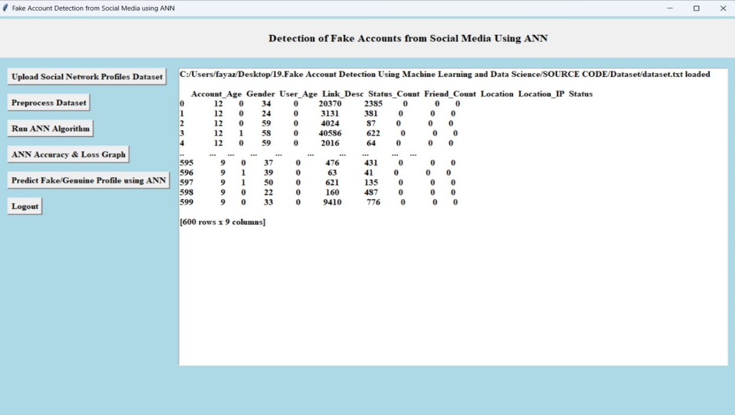
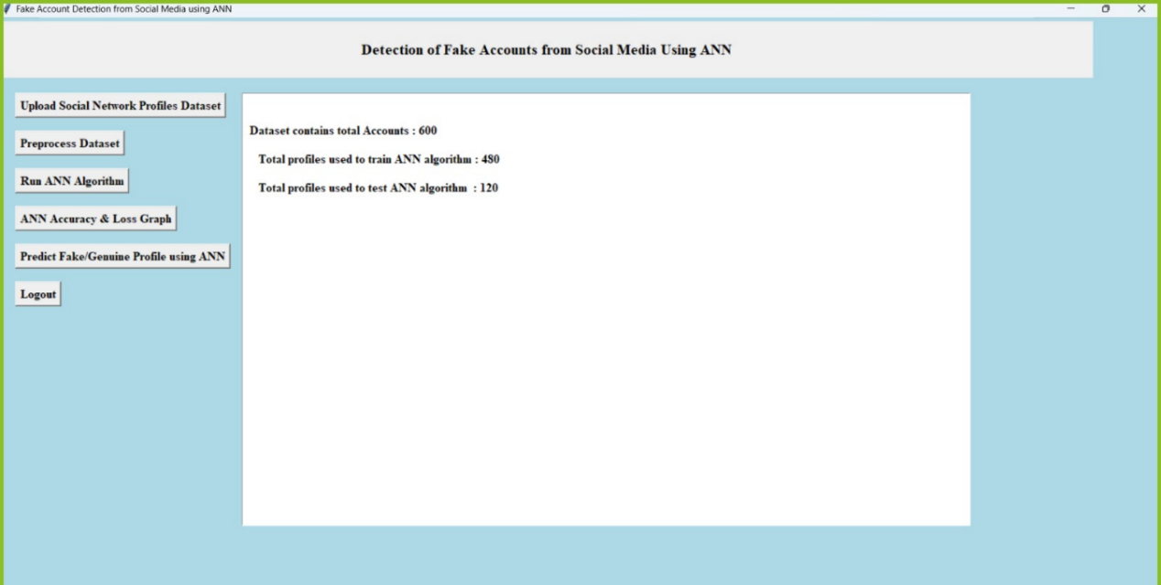

Slide 38
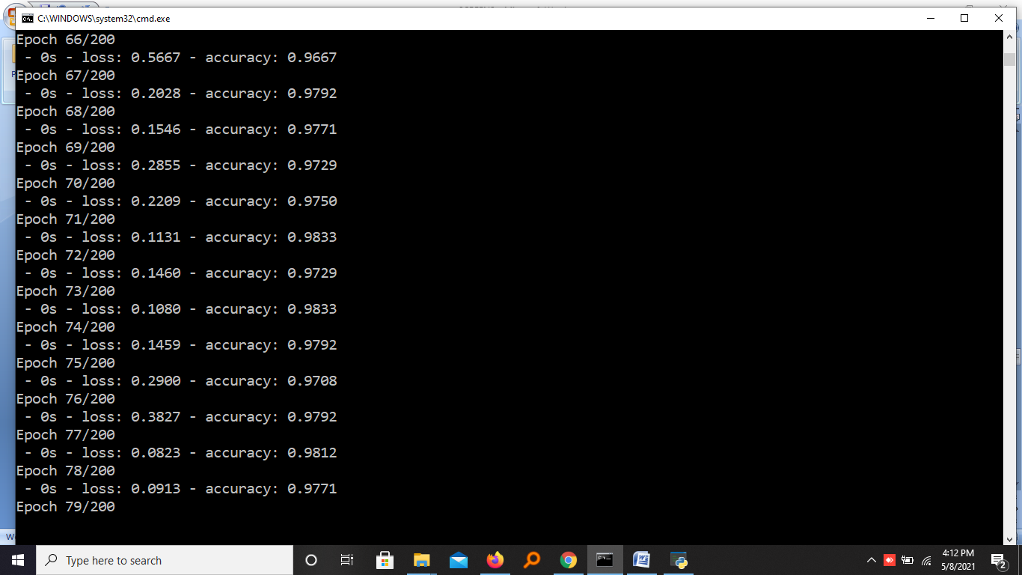
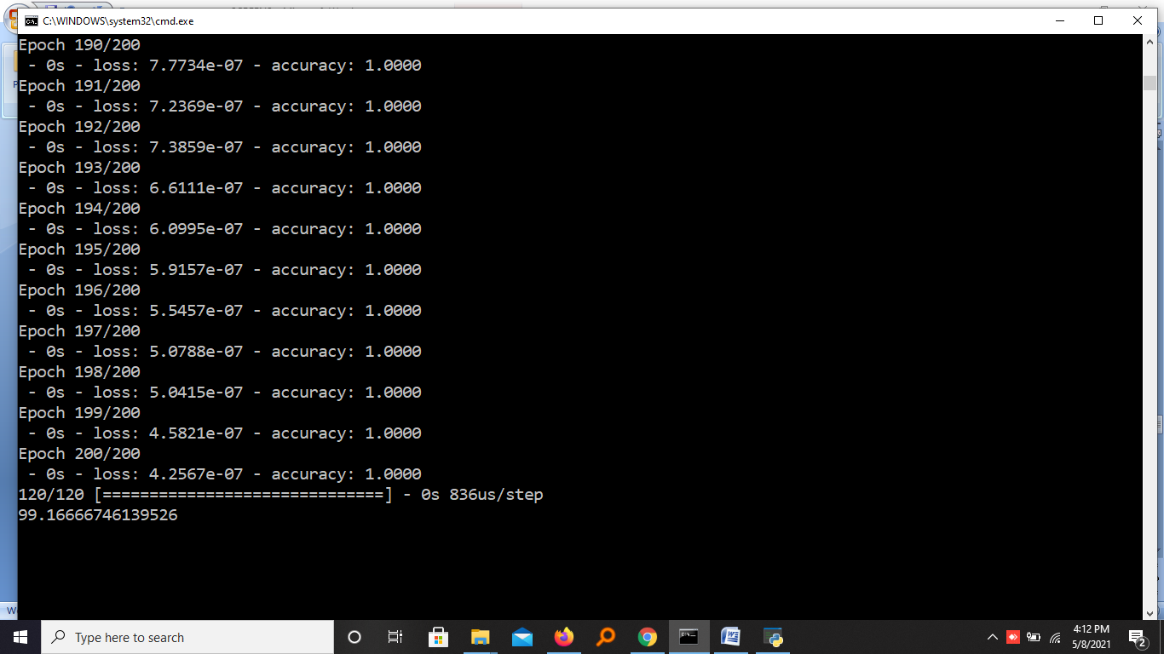

Slide 39


Slide 40
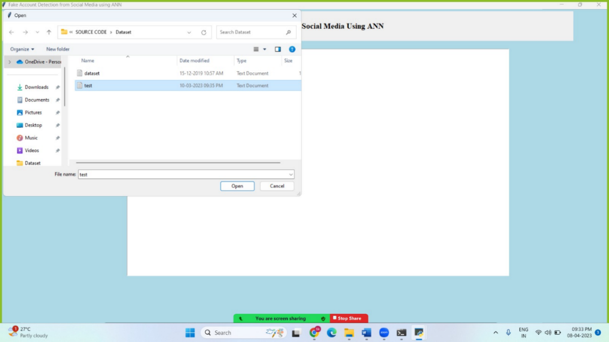
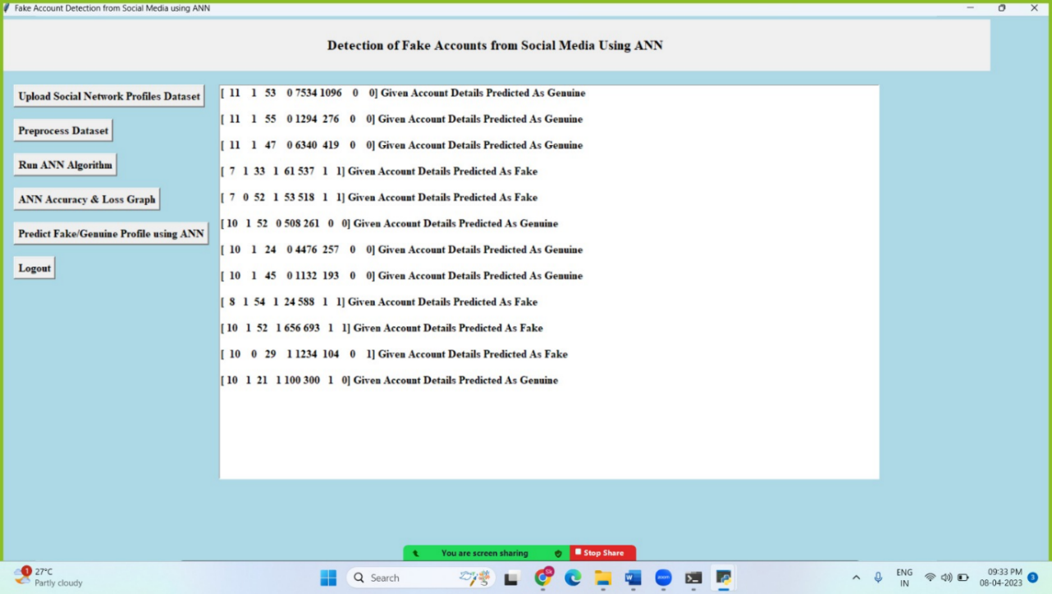

Slide 41
Conclusion
We use machine learning, namely an artificial neural network to determine what are the chances that a friend request is authentic are or not. Each equation at each neuron (node) is put through a Sigmoid function. We use a training data set by Facebook or other social networks. This would allow the presented deep learning algorithm to learn the patterns of bot behavior by back propagation, minimizing the final cost function and adjusting each neuron's weight and bias.

Slide 42
FUTURE SCOPE
This technique can also be used for other social networking sites such as Facebook or Twitter and LinkedIn with minor changes.
The accuracy of the proposed technique can also be improved using different feature selection techniques.
Finally, we intend to enrich the dataset further and look forward to observing the results of other elements of the boosting methods.

Slide 43
References
https://www.statista.com/topics/1164/socialnetworks/
https://www.cnbc.com/2018/01/31/facebookearnings-q4-2017- arpu.html
https://www.cnet.com/news/facebookbreach-affected-50-millionpeople/
https://www.facebook.com/policy.php
https://stackoverflow.com/questions/40758562/c an-anyone-explain-mestandardscaler
https://pandas.pydata.org
https://www.tutorialspoint.com/python_pandas/i ndex.html

Slide 44
THANK YOU

